Slide 1
Image Retrieval Using CycleGAN
Presented by:
Rajat Gireesh Kuballi
2GI20EC058

Slide 2
Contents
Image Retrieval
CycleGAN
Steps Involved in Image Retrieval Using CycleGAN
Application
Accuracy
Conclusion

Slide 3
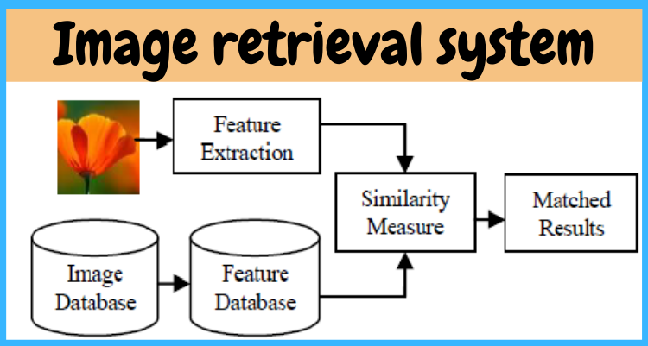
What is Image Retrieval?
Image retrieval refers to the process of searching and retrieving specific images from a large collection or database based on their content, visual features, or similarity to a given query image. It involves techniques and algorithms that analyze and compare image attributes such as color, texture, shape, and spatial distribution.

Slide 4
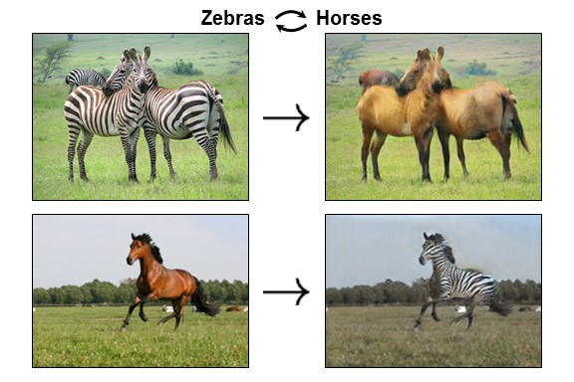
What is CycleGAN?
CycleGAN, short for Cycle-Consistent Generative Adversarial Network, is a type of deep learning model that is used for unsupervised image-to-image translation tasks. It is specifically designed to learn mappings between two different domains without requiring paired training data.

Slide 5
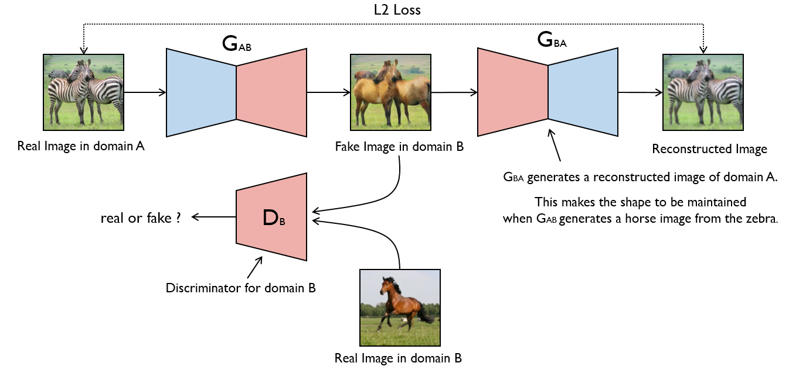
Steps involved in Image Retrieval using CycleGAN
1)Dataset Collection
2)Data Preprocessing
3)Train CycleGAN
4)Cycle Consistency Loss
5)Model Evaluation:
6)Feature Extraction
7)Similarity Measurement
8)Query Processing
9)Image Retrieval
10)Result Presentation

Slide 6
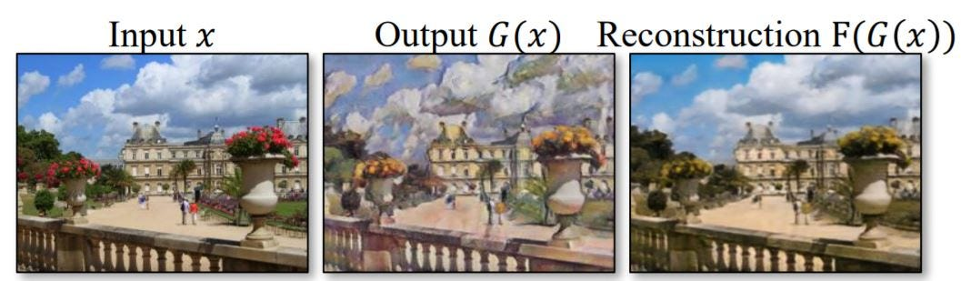
Application:
Transfer for live video streams:
In this application, CycleGAN can be used to transfer the artistic style of a reference image or painting onto a live video feed in real-time. The algorithm continuously captures frames from the video stream, processes each frame using CycleGAN, and applies the desired artistic style to the frames in real-time. The result is a live video stream that appears as if it has been painted or stylized in the chosen artistic style.

Slide 7
Accuracy:
The accuracy of image retrieval using CycleGAN can vary depending on various factors such as the quality of the training data, the size of the dataset, the complexity of the images, and the specific implementation of the CycleGAN Overall, the accuracy of image retrieval using CycleGAN can be competitive with other state-of-the-art methods, but it requires careful experimentation, optimization, and validation to achieve optimal performance for a given dataset and retrieval task. model.

Slide 8
Conclusion:
Image retrieval using CycleGAN offers a valuable approach for matching and retrieving images across different domains, opening up new possibilities in content-based search and recommendation systems. Its ability to learn domain mappings without paired training data makes it a versatile and powerful tool for various applications in the field of computer vision.

Slide 9


